Slide 1


Presentation of
PREDELL SERVICES
Notes:
"Good morning, everyone.”
"Today, I'll be giving a presentation on Predell Services, the company where I did my internship."
"As you can see from their logo, their business is all about 'trace and flow'—which means tracing data and managing data flows."

Slide 2
SUMMARY
Introduction to the company
What we do
Internal structure
Clients & Organization
My first assignment

Slide 3
PREDELL Services: At a Glance

Slide 4
PREDELL Services: At a Glance
  Who ? An IT services company (ESN) with about 40 engineers and technicians.
  Where ? Based in Angers
  History : Founded in 2003 , "Predell Services" entity created in 2008.
Notes:
"So, who is Predell? They are an IT services company, known as an ESN in France. "
"They are a local company, based right here in Angers. "
"The company has about 40 engineers and technicians. "
"A quick look at their history: The original company was founded in 2003, and the 'Predell Services' entity, as it is today, was created in 2008. "

Slide 5
What We Do: Core Expertise

Slide 6
What We Do: Core Expertise
Main Specialization
Services Pole
Product Pole
Automated Data Exchange (EDI)
Traceability Systems
Manages client integration projects (on TradeXpress, Mulesoft, etc.).
Develops in-house software, mainly for traceability.
Notes:
What does Predell actually do? Their work is very specialized."
"They have two main areas of expertise:"
"First, Automated Data Exchange, which is also called EDI. This is about making different business systems communicate automatically."
"And second, Traceability Systems, which involves tracking products or information through a supply chain. “
"Internally, the company is organized into two main departments, or 'Poles'."
"First, the Services Pole, which is where I worked. This team manages client integration projects using tools like TradeXpress and Mulesoft."
"Second, the Product Pole. This team develops Predell's own in-house software, primarily for traceability solutions."

Slide 7
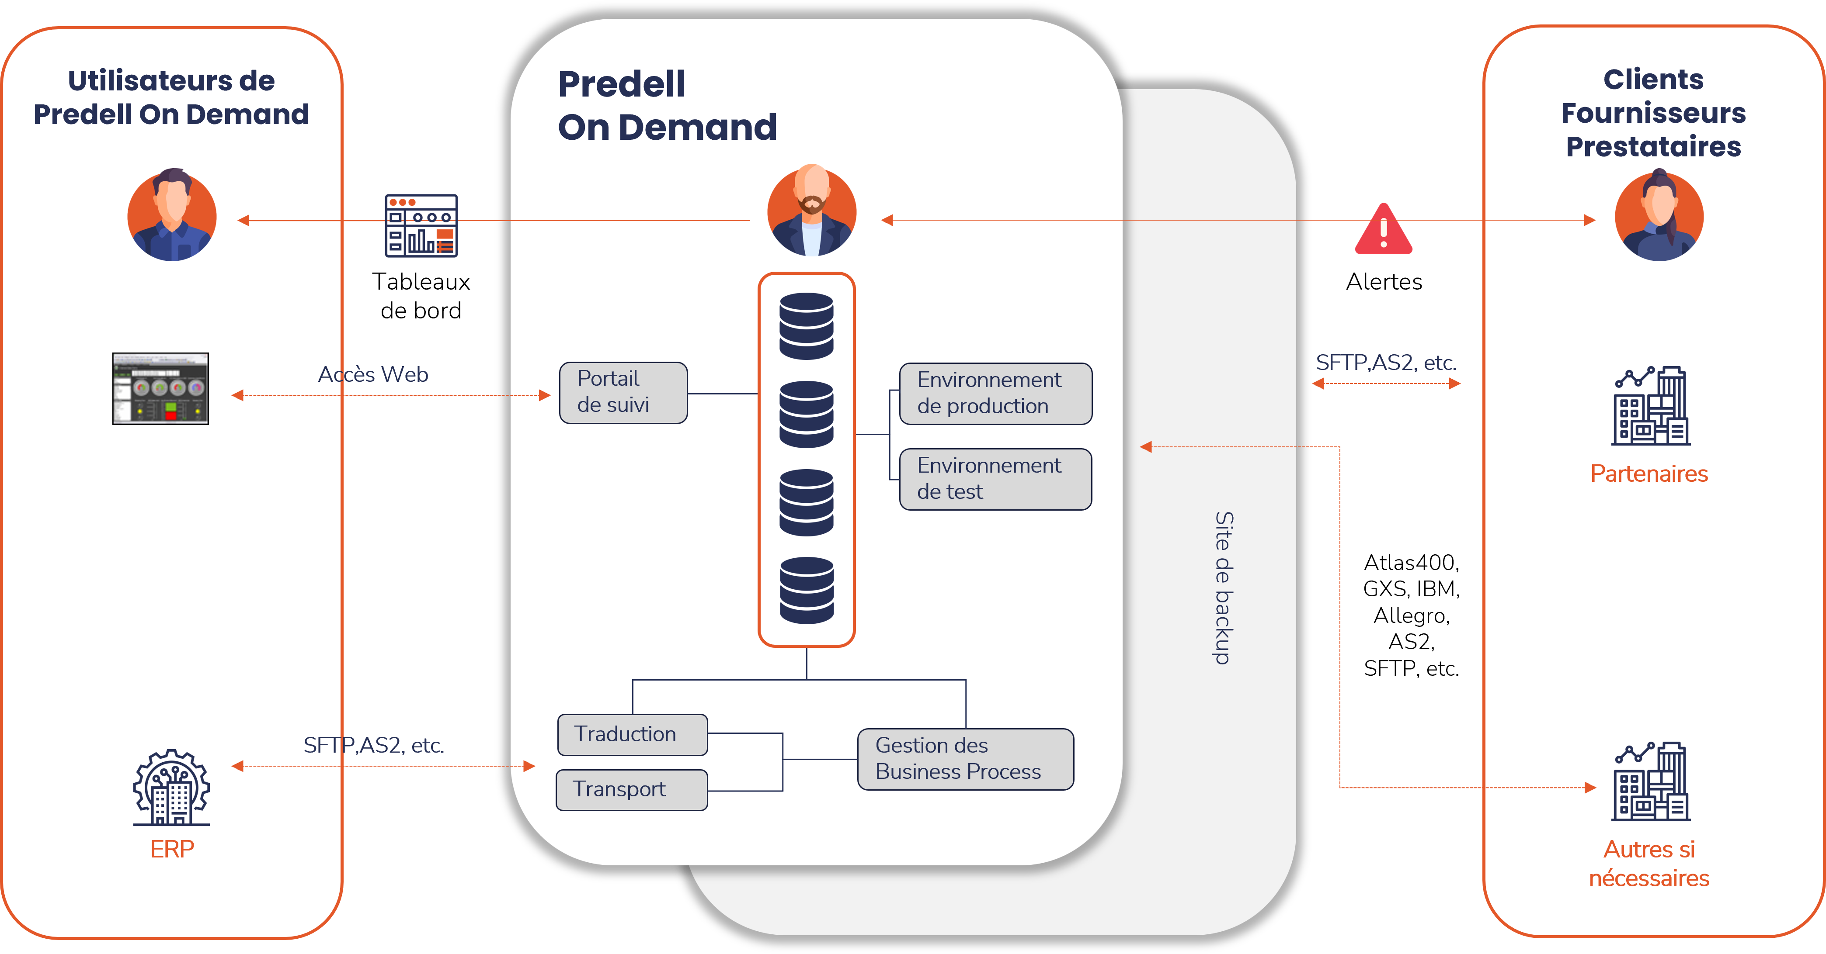
Services Pole
Notes:
"This diagram shows 'Predell On Demand,' which is a perfect example of their 'flow' or EDI business."
"Think of it as a central hub or a universal translator."
"On the left, you have the company (the user) with its internal system, like an ERP."
"On the right, you have all its external partners—customers, suppliers, etc."
"Instead of the user building 50 different connections, they just connect once to Predell."
"Predell then translates and transports the data to every partner in the exact format they need. It also manages alerts and business processes."

Slide 8
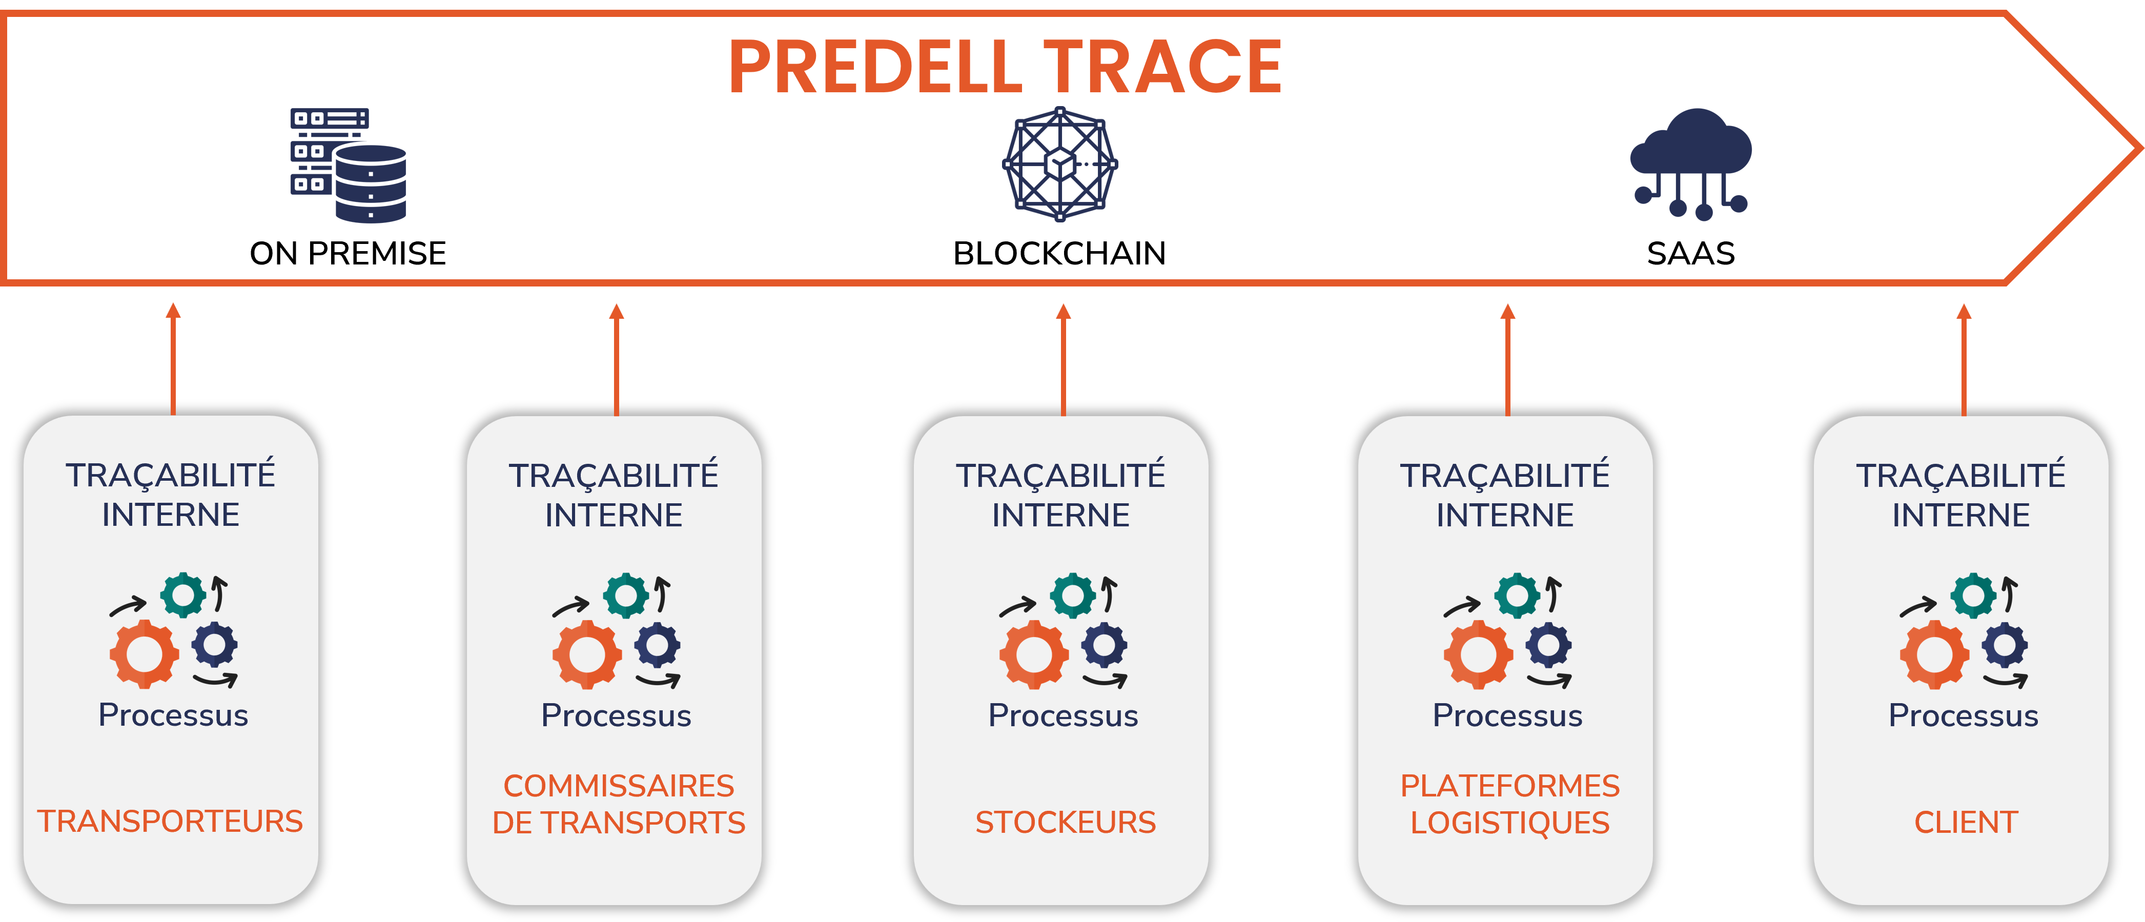
Product Pole
Notes:
"This diagram shows 'Predell Trace,' which is their 'trace' or traceability solution."
"At the bottom, you have all the different partners in a supply chain: carriers, warehouses, logistics, and the client."
"Each one has its own internal tracking system."
"Predell Trace acts as a central control tower. It collects the tracking data from all of these different partners and stores it in one place."
"This gives the client a single, unified view to see exactly where their products are at any time."

Slide 9
CLIENTS & ORGANIZATION

Slide 10




CLIENTS & ORGANIZATION
Our Main clients
Full Project Lifecycle
Key Technologies
SAFRAN
MANITOU
SONEPAR
HUTCHINSON
(…)
We cover the full cycle:
Study
Design
Development
Configuration
Maintenance
TradeXpress
Mulesoft
Cdata Arc
Grafana
Notes:
"This slide gives a quick overview of their work."
"First, you can see some of their main clients, which are large, well-known industrial groups like SAFRAN, MANITOU, SONEPAR, and HUTCHINSON. "
"Second, it shows their process. They manage the full project lifecycle—from the initial study and design, all the way through development, configuration, and maintenance. "
"Finally, these are the key technologies they use, including major EDI platforms like TradeXpress and Mulesoft."

Slide 11
My First assignment : A Data Translator for GRDF
The challenge :
Our solution
The client had data in a very specific, custom format.
They needed to send this data to partners in a universal, standard format (Format "EDIFACT").
I developped a translator program in the middle.
Input (from SICAME) : Text file with data in a specific position
- Output (to GRDF) : Standard « DESADV » Message (Despatch Advice)
Notes:
"Now, I'd like to quickly talk about my first assignment."
"The challenge was for a client who needed to send data to GRDF. "
"The client's data was in a very specific, custom text format. But GRDF required a universal, standard format called 'EDIFACT'. "
"My solution was to develop a translator program that sits in the middle. "
"It takes the client's custom text file as the input... "
"...and it converts it into a standard EDI 'DESADV' message for the output, which GRDF can understand. "

Slide 12
MY FIRST
IMPRESSION

Slide 13

THANK YOU FOR LISTENING

